Slide 1
LearnEra (Learn from Anywhere)
December 15, 2023

Slide 2
Group Members:
1.Harika Randhi - 10732133
2.Madhan Mohan Bajanthri - 10731064
3.Geetha Kone - 10731826
4.Prajwal Padule - 10731476

Slide 3
Objective:
The main aim is to build a user friendly E-Learning platform where user can access it from anywhere with a few clicks
To achieve the web application of E-Learning through AWS Services like S3, EC2, RDS, GLUE, Athena and QuickSight.
To host the website serverless and perform complex analysis on the user data.
To have a digital visualization in graphs, charts using Amazon services like QuickSight.

Slide 4
AWS Services:
EC2
S3
RDS
GLUE
ATHENA
QuickSight

Slide 5
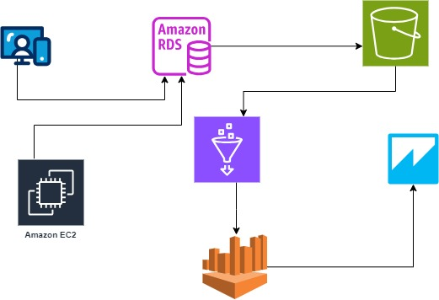
Services Flow Chart:

Slide 6
EC2 (Elastic Compute Cloud):
Amazon EC2 is a web service that provides sizable compute capacity in the cloud. It is designed to make web-scale computing easier for developers.
It allows users to work with number of virtual machines and servers and storage by using the instance types.
By using the EC2 keypair we can securely communicate with EC2 instances.
You can create a new security group or select an existing one. Security group which acts as a virtual firewall, controls inbound and outbound traffic. Configuring rules for SSH, HTTP, HTTPS, and other necessary protocols.

Slide 7
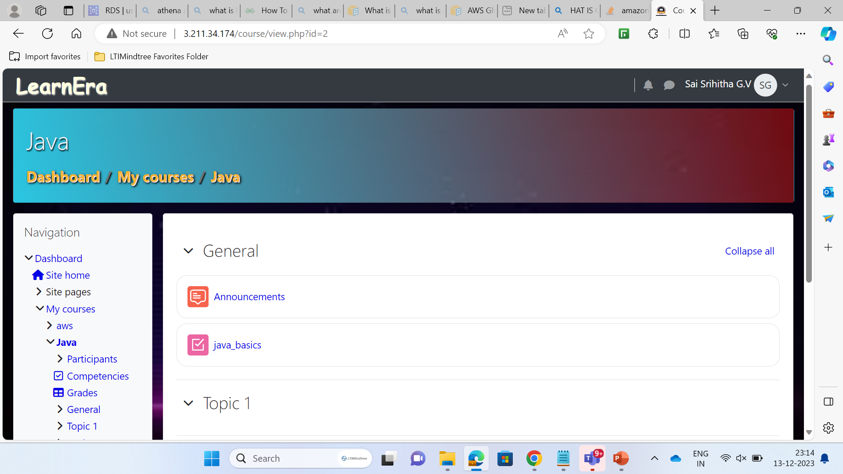
User Interface:

Slide 8
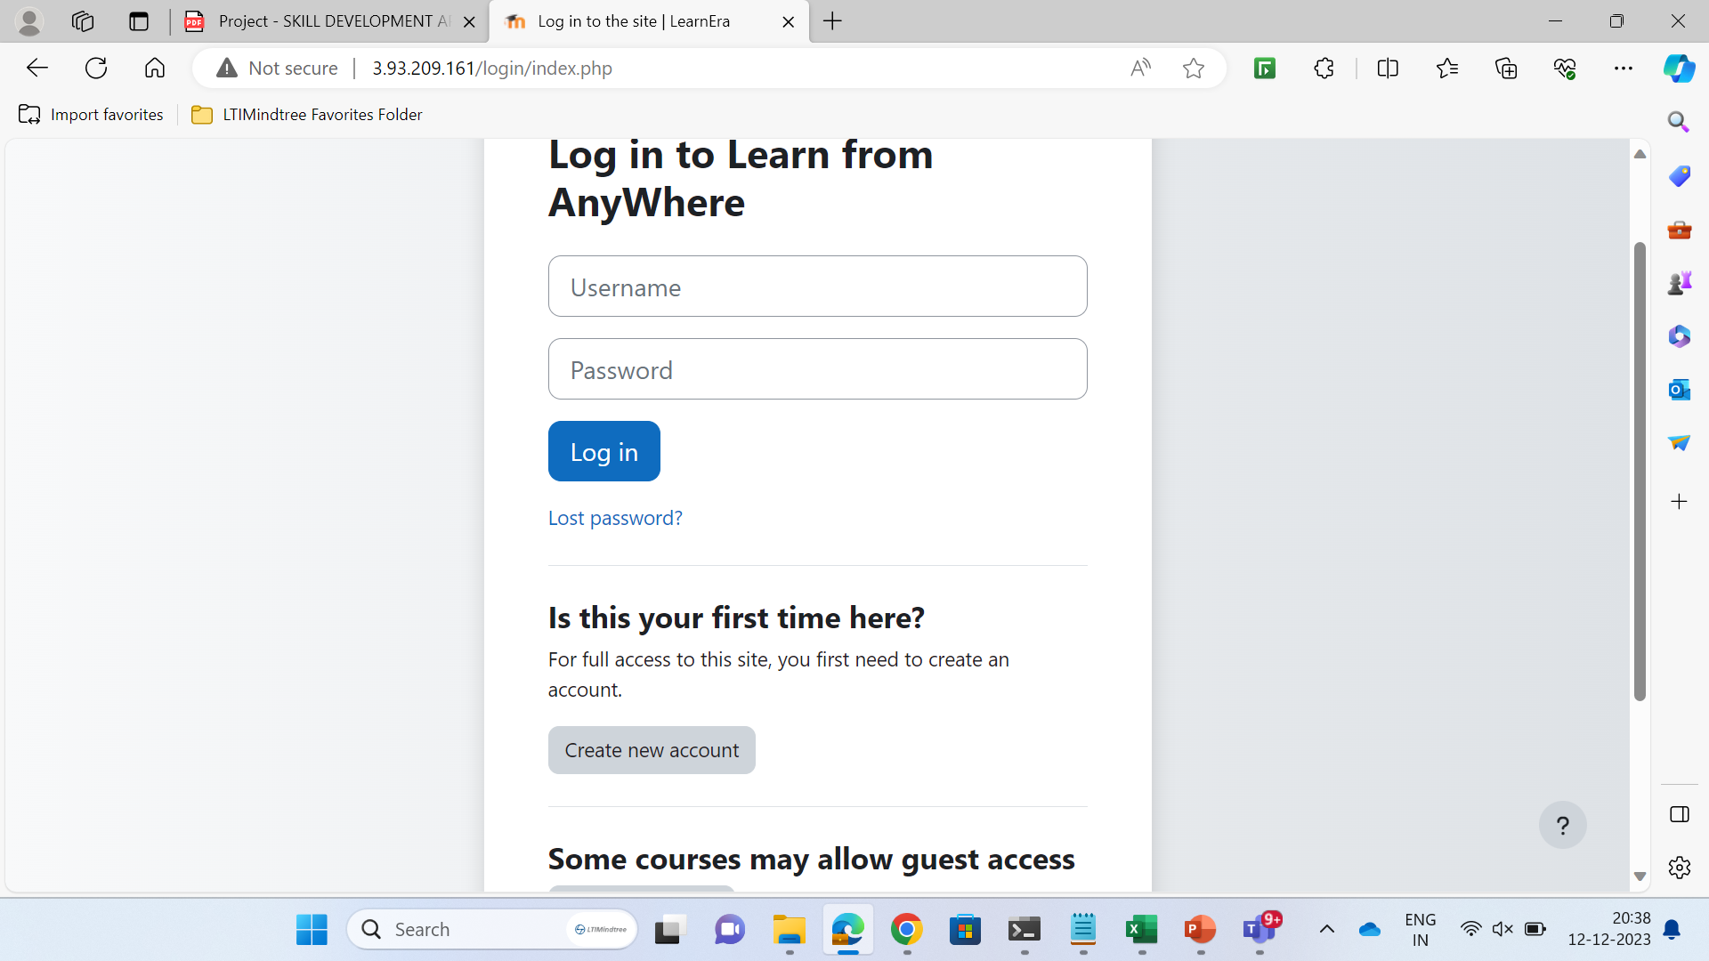
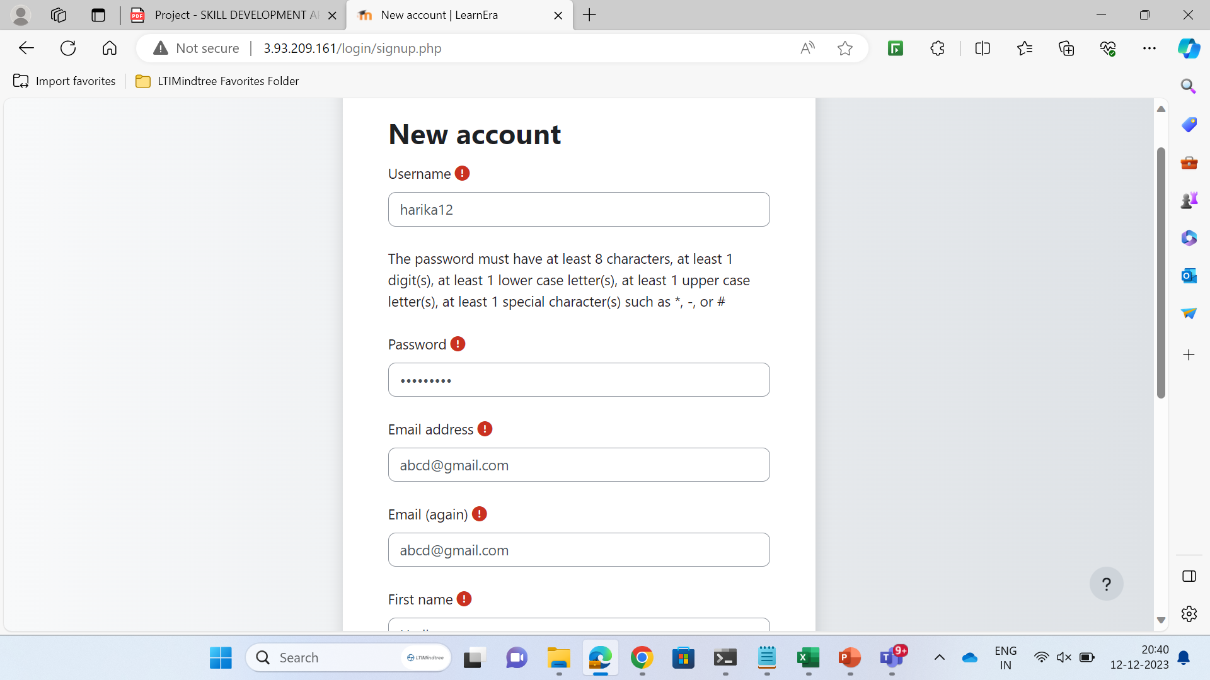
User Access to WebApp: LearnEra

Slide 9
RDS(Relational Database Service):
Amazon relational Database Service (Amazon RDS) makes it easy to set up, operate, and scale a relational databases in the cloud. By eliminating tedious manual tasks, Amazon RDS frees you to focus on your application and your users.
Cost-efficient, Scalable , Easy to setup , Backup/Restore.
Users can use many database engines like Amazon Aurora, PostgreSQL, MySQL, Oracle DB ,SQL Server, etc.
User can use their own VPC(virtual private network) for their database.

Slide 10
S3(Simple Storage Service):
Amazon S3 is an object storage service that offers industry-leading scalability, data availability, security, and performance.
Store and protect any amount of data for a range of use cases, such as data lakes, websites, cloud-native applications, backups, archive, machine learning, and analytics.
Amazon S3 is designed for 99.999999999% (11 9's) of durability, and stores data for millions of customers all around the world.

Slide 11
GLUE:
AWS Glue uses other AWS services to orchestrate your ETL (extract, transform, and load) jobs to build data warehouses and data lakes and generate output.
It helps make sure that the information your app needs is neat and tidy, not messy. If your app uses data from different sources (like files, databases, etc.), Glue helps bring it all together so your app can understand it.
It has a special place (catalog) where it keeps information about your data. This makes it easy to find and use.
CRAWLER:
You can use a crawler to populate the AWS Glue Data Catalog with tables. This is the primary method used by most AWS Glue users. A crawler can crawl multiple data stores in a single run. Upon completion, the crawler creates or updates one or more tables in your Data Catalog. Extract, transform, and load (ETL) jobs that you define in AWS Glue use these Data Catalog tables as sources and targets.

Slide 12
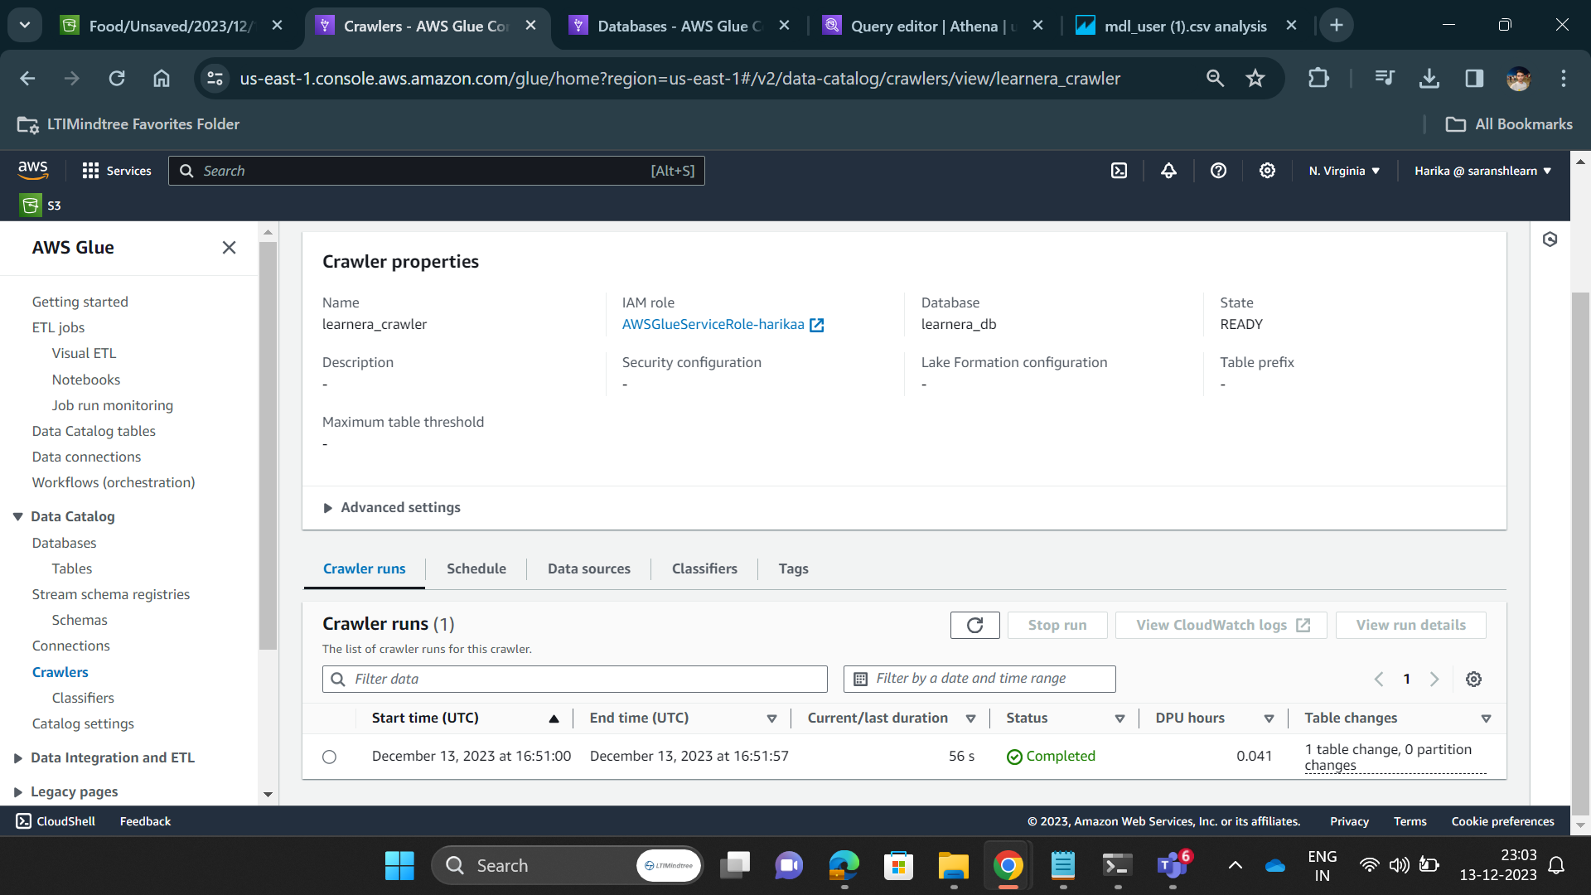
Using Glue:

Slide 13
ATHENA:
Amazon Athena is an interactive query service that makes it easy to analyze data in Amazon S3 using standard SQL.
Athena is serverless, so there is no infrastructure to setup or manage, and you pay only for the queries you run.
To get started, simply point to your data in S3, define the schema, and start querying using standard SQL.

Slide 14
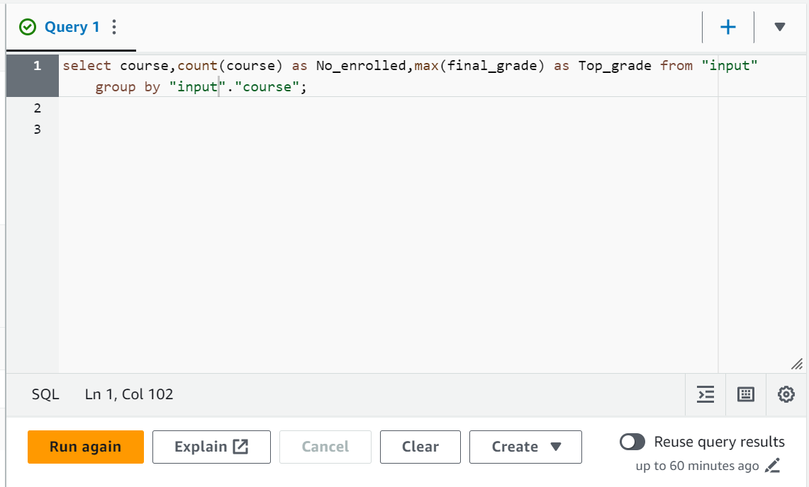
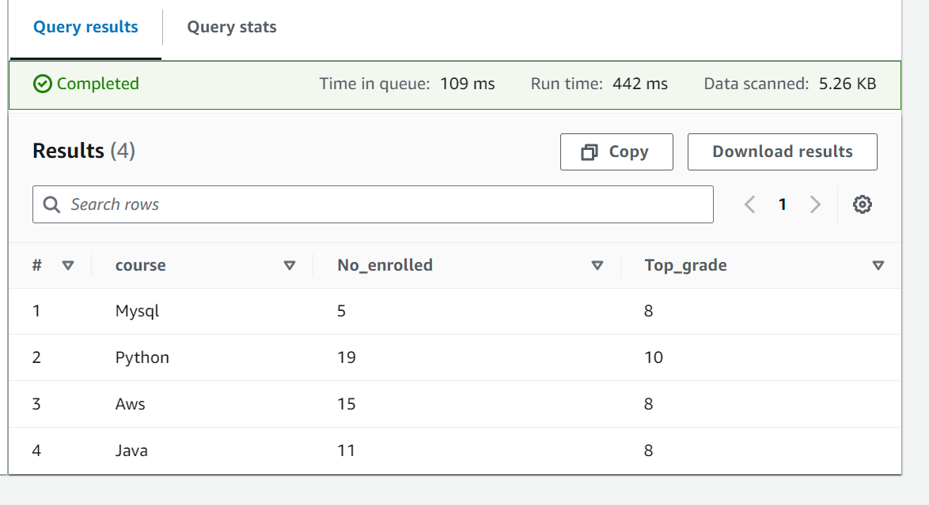
AWS Athena:

Slide 15
Amazon QuickSight:
Amazon QuickSight ,as a business intelligence tool, could be utilized in a skill development application to create interactive dashboards and visualizations based on the data stored in services like Amazon Athena other data sources.
QuickSight can help visualize learner progress , course effectiveness , engagement metrics, and other relevant data.
These visualization enable better decision making , allowing the platform to tailor learning experiences, identify areas for improvement , and track the success of skill development initiatives.

Slide 16
Tool Used: Moodle
Moodle Is A Flexible & Customizable Learning Platform To Help You Streamline Teaching. LMS(learning management system a learning management system (LMS) is a software application)
Creating and Managing Courses
Interactive Learning
Checking Progress
Different Types of Learning
Doing Tests and Assignments
Making Learning Personal
Using on Phones and Tablets

Slide 17
Working with AWS Services:
Step1: We are creating a new EC2 instance.
Step2: We are creating a new database instance using RDS.
Step3: We are accessing the database instance through EC2. So, we are accessing the ec2 private address and connecting our RDS To EC2 through VPC security groups.
Step4: We are connecting to our ec2 cli(command line interface) using the public Ip address and communicating to instance through instance key pair.
Step5: We will install all the frontend and required backend software such as Apache2, php, and MySQL client on the instance.

Slide 18
Step6: We create a web page in the frontend using php
Step7: The software is hosted on created RDS and access the database in the RDS. The tables are observed and exported to s3 bucket using S3 plugins and automated job process.
Step8: Crawlers are created in Glue service so that it can crawl multiple data stores in a single run. And it is also used to populate the AWS Glue Data Catalog with tables.
Step9: We access the tables through Athena and perform analysis on the dataset or the tables.
Step10: We perform data visualization tasks using Amazon QuickSight service. We can achieve graphical representation of complex analysis of data using Amazon QuickSight.
Such as Bar Graphs, Pie charts,etc..

Slide 19
Automated Process:
For the automation(i.e. to export the data from the database to s3 bucket) we are using MySQL client.
We will use all the tables that are required from the database and dump it using MySQL dump and copy it to a file of any format we require(here we copied it as .csv file).
Copy this file to the S3 bucket by accessing the bucket where the required file need to be stored.
After copying it make the copy of the files in s3 and automate the process by applying crone jobs through cli.
Cron jobs are performed so that the update the file happens for every 5min or user desired timeline.

Slide 20
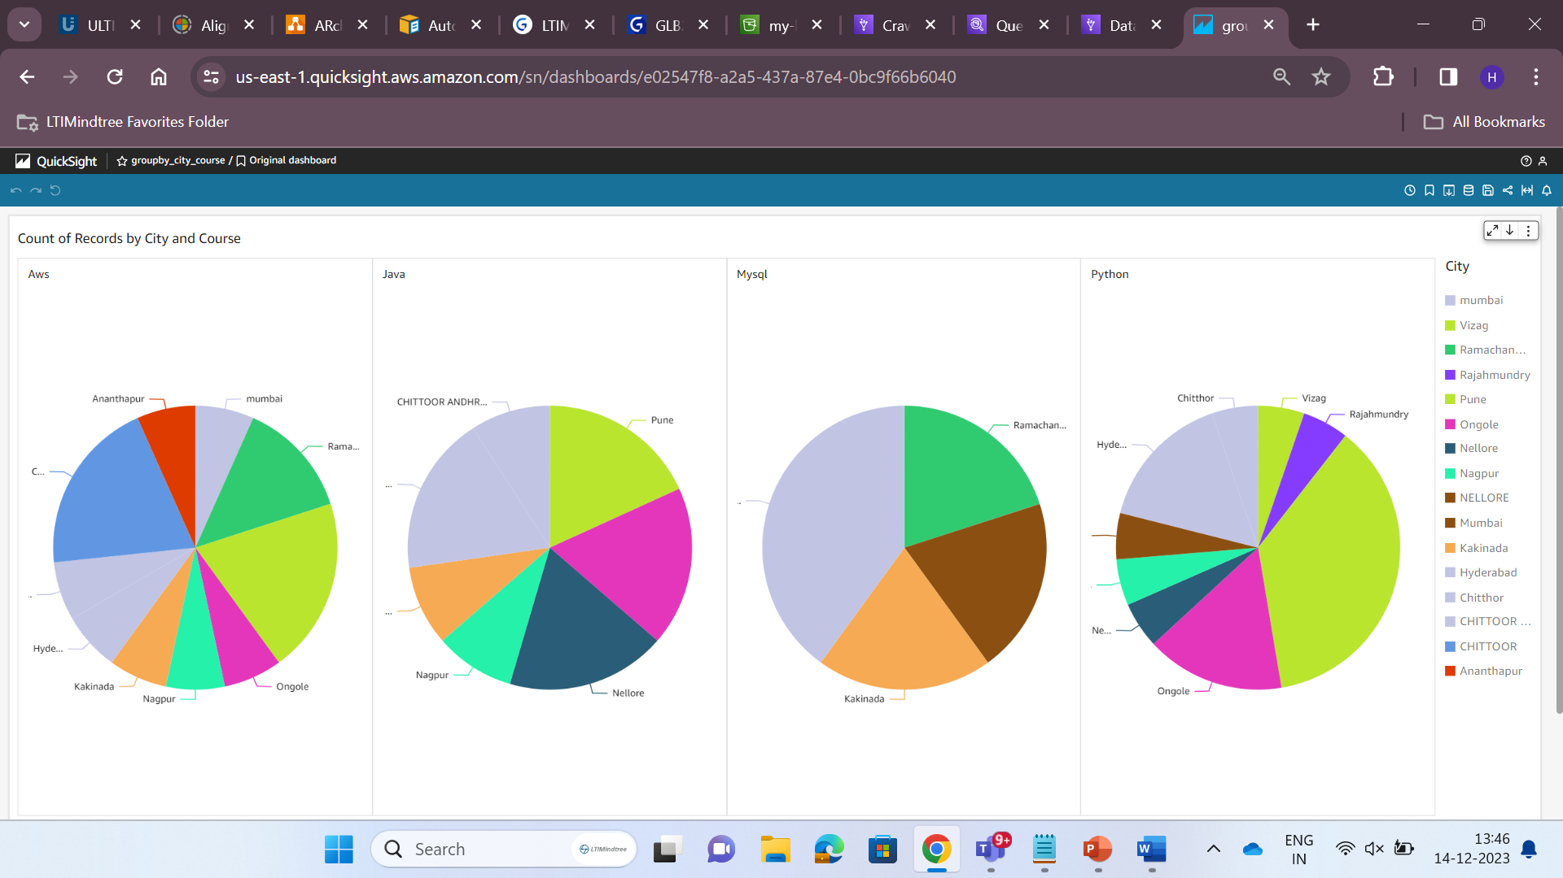
QuickSight(Data Visualization):

Slide 21
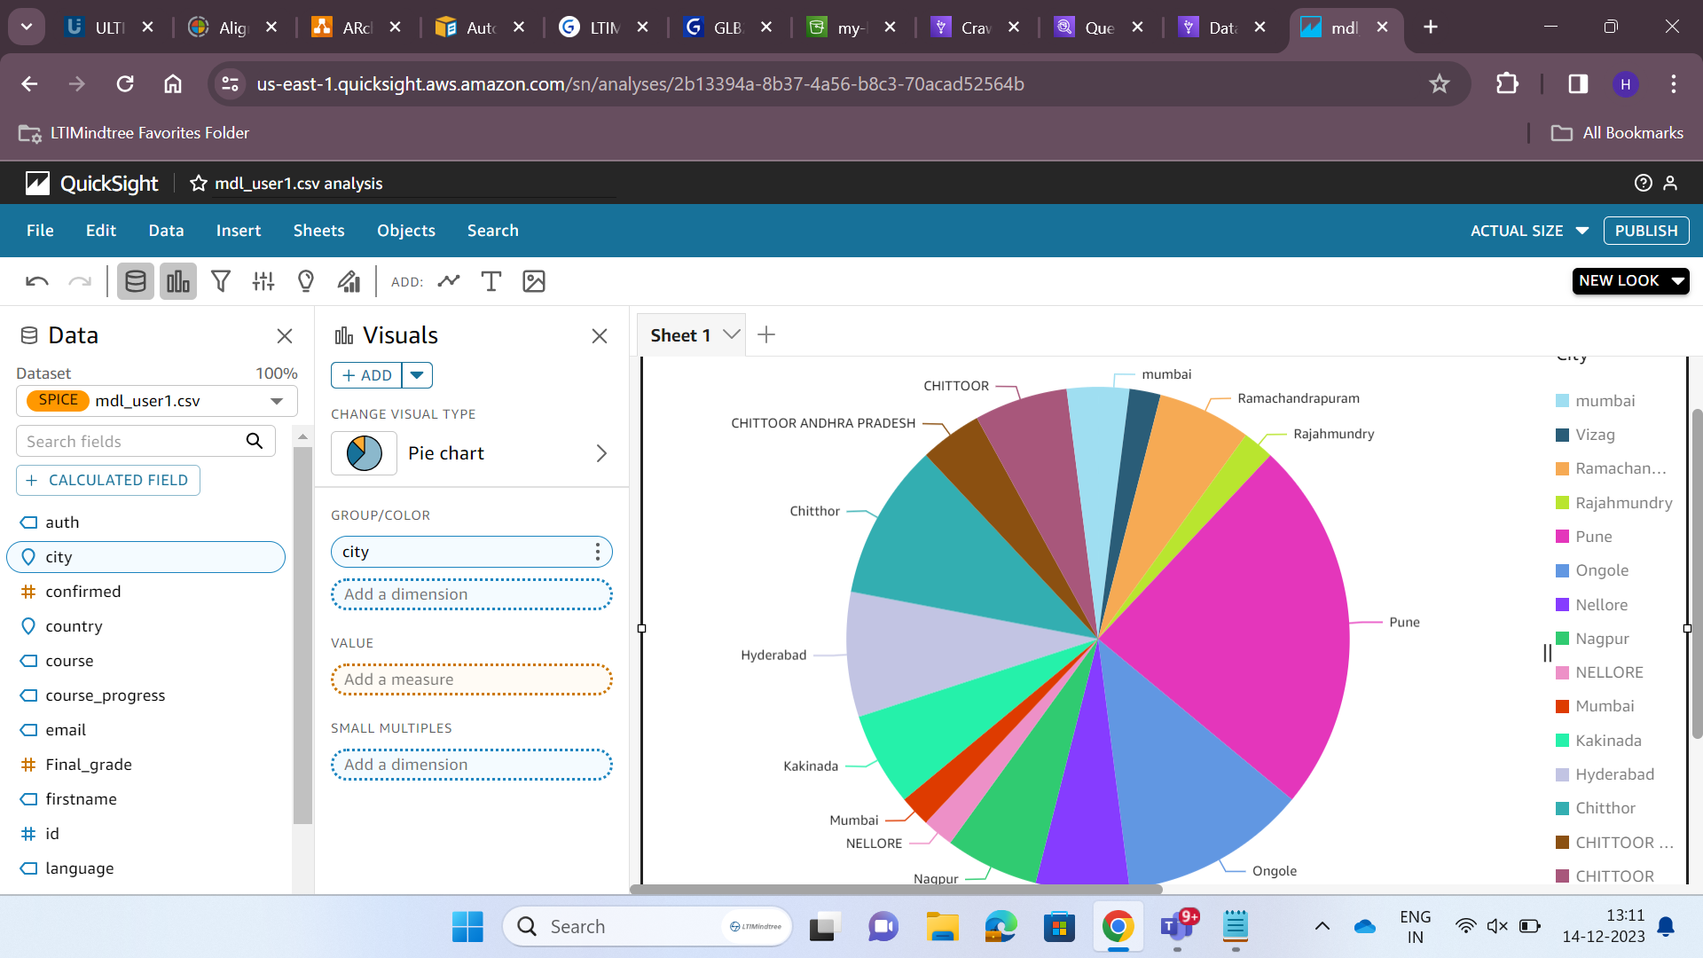

Slide 22
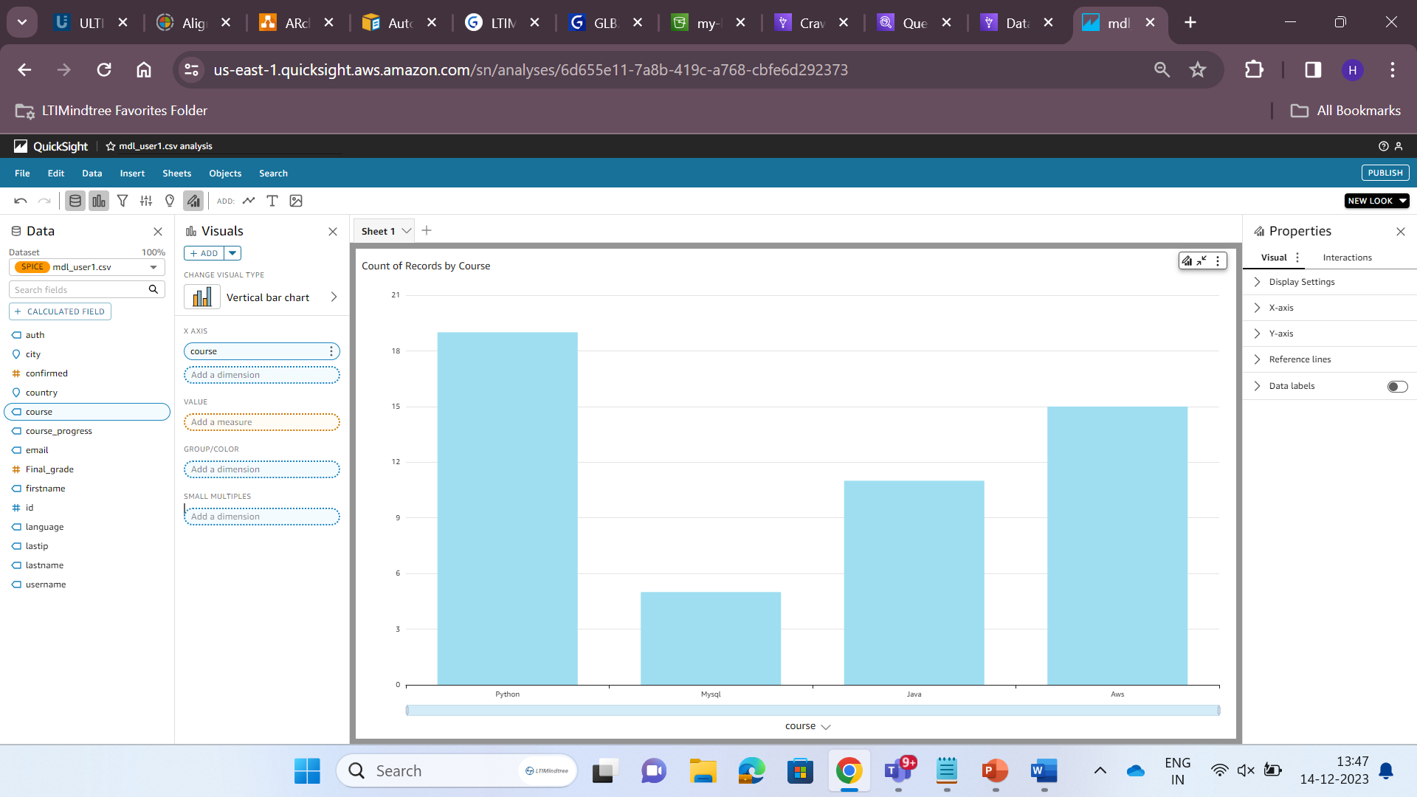

Slide 23
FUTURE SCOPE:
After querying and analysing the bigdata we can make decisions and make it efficient by giving the suggestions to the users using SNS via emails or SMS.

Slide 24
THANK YOU

